Slide 1

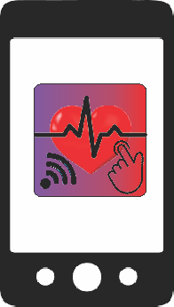
ARDUINO2
…Mending Broken Hearts through Design, HealthCare & Engineering
By:
Nicholas Landi
Scott Hinden
Daisy McCoy
Johnson Odibi
Ivette Perez

Slide 2

ABOUT
THE HEART-HEALTHY APP
ArduinO2 is a prototype medical application that measures the partial arterial blood oxygen level (SpO2) and pulse rate respectively, by interfacing with an e-Health Sensor Shield and an Arduino device. The Arduino now transmits the results via bluetooth to a mobile platform being the Android device.

Slide 3
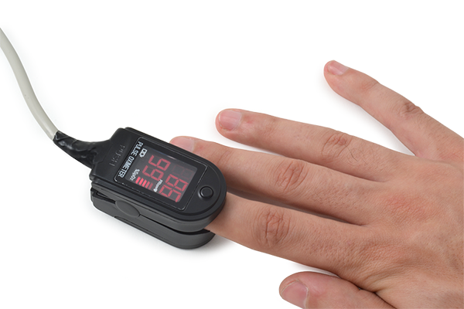
Pulse Oximeter
Pulse oximeters are small, lightweight monitors that painlessly attach to a fingertip to monitor the amount of oxygen carried in the body.
It measures the SP02 % in the body.
It measures the pulse rate of the user.
Measures Hemoglobin and Deoxyhemoglobin levels in blood by two different light wavelengths. The absorption coefficients are measured using two wavelengths 660 nm (red light spectra) and 940 nm (infrared light spectra).
To calculate the arterial oxygen saturation a photo-detector perceives the non-absorbed light from the LEDs.
The accepted ranges for patients are from 95 to 99 percent except those with a hypoxic drive problem is between 88 to 94 percent.

Slide 4
Patients
Recommended for patients whose oxygenation is unstable: intensive care (heart failure), operating, recovery, emergency and hospital ward settings, and pilots in unpressurized aircrafts.
The accepted ranges for patients are from 95 to 99 percent except those with a hypoxic drive problem is between 88 to 94 percent.
Heart failure is when the heart is weak and cannot pump blood effectively.

Slide 5
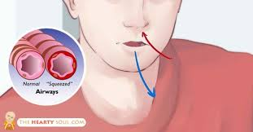




POTENTIAL MARKERS
OF HEART FAILURE
SHORTNESS OF BREATH
after activity, while
sleeping or all the time

Slide 6
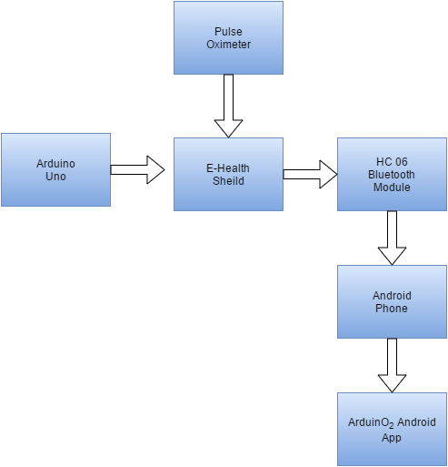
Functionality Engineering

Slide 7
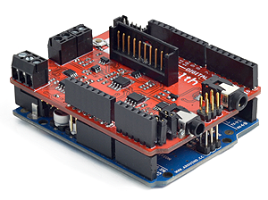
E- Health Shield
A shield for an Arduino microcontroller that can be used to interface with health care devices.
With this device it is possible to receive biometric data from a patient.

Slide 8
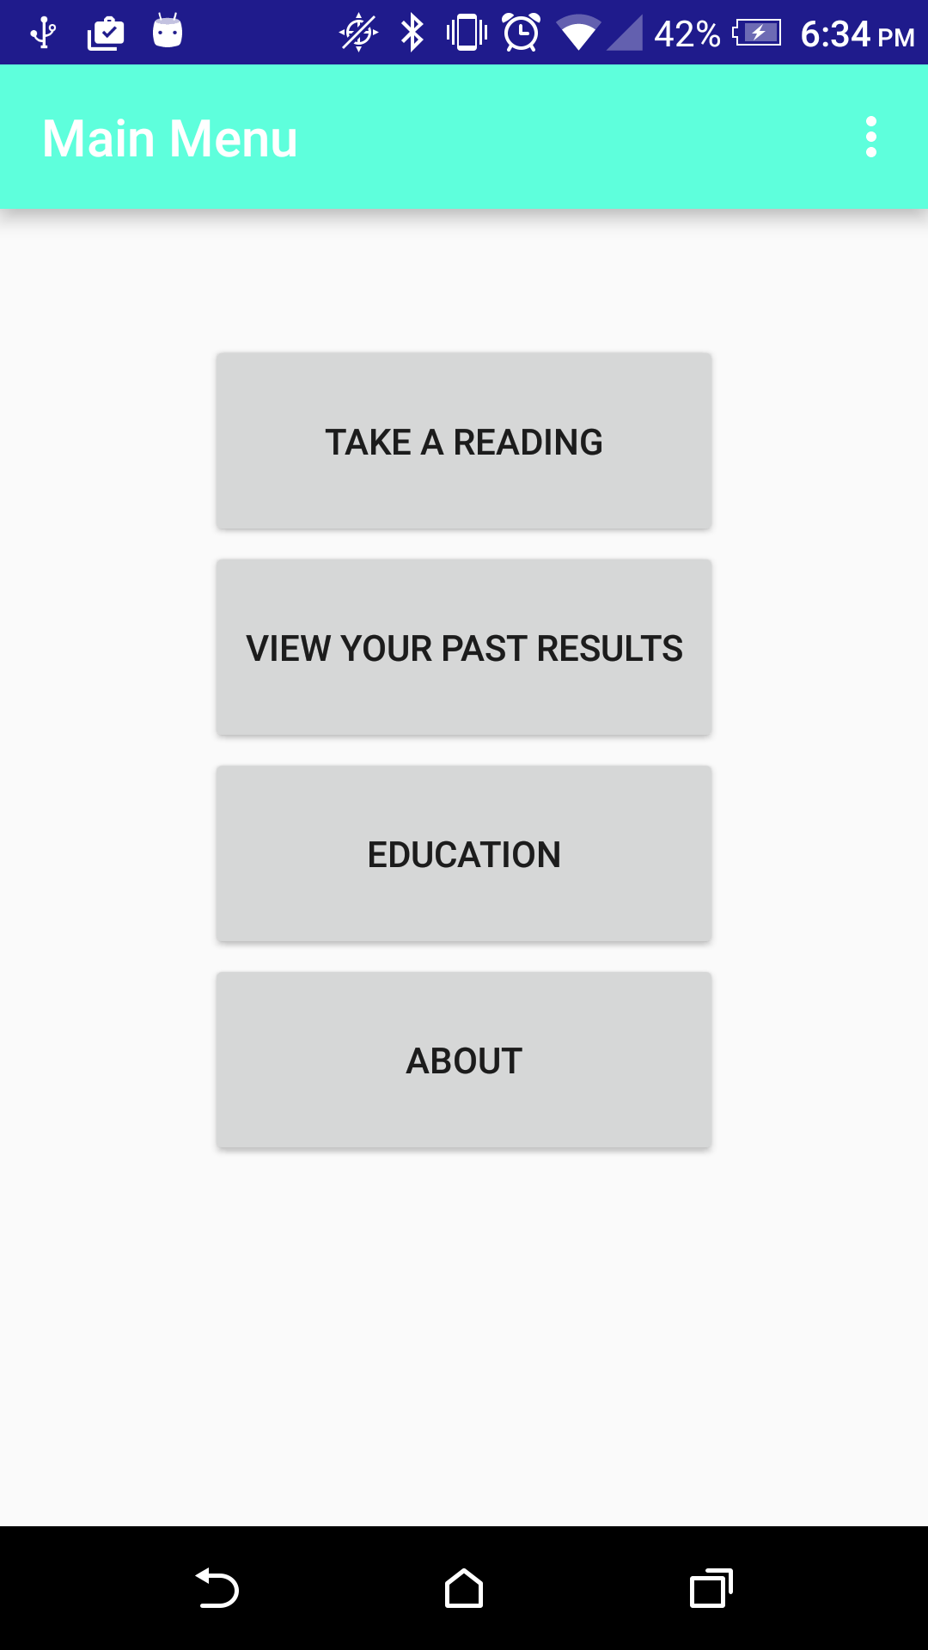
Main Menu
Allows the user to take a reading
User can view their past results
User can view education about the heart.
View what the app is about.

Slide 9
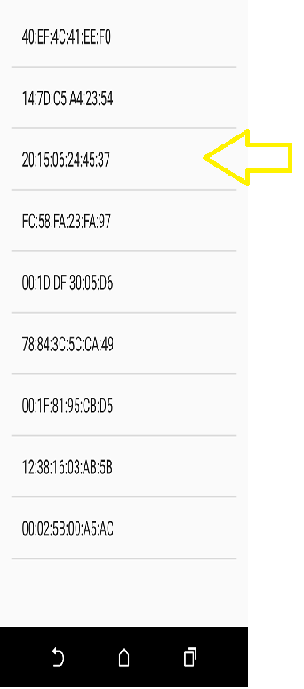
Taking a Reading
The user must first pair with the bluetooth module connected to the Arduino and E-Health Shield.

Slide 10
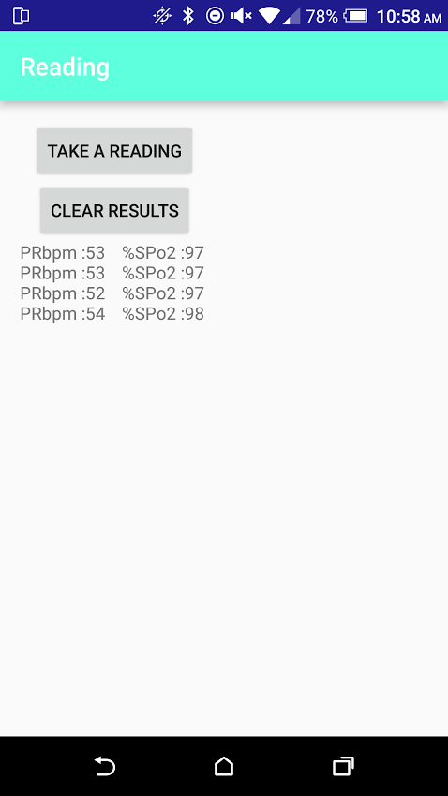
Taking a Reading
From there the user can take a reading by pressing the take a reading button.
After about a minute the average results will be displayed on the screen.

Slide 11
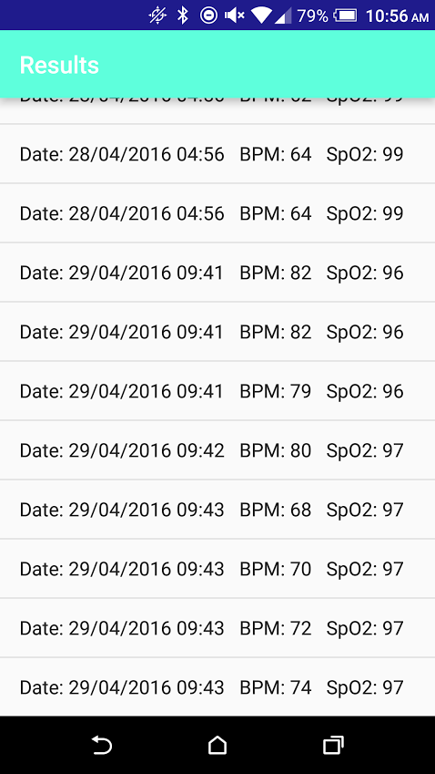
View Results
The user can view past results of the the readings they took from the pulse oximeter.
The results are listed in date and time order.

Slide 12
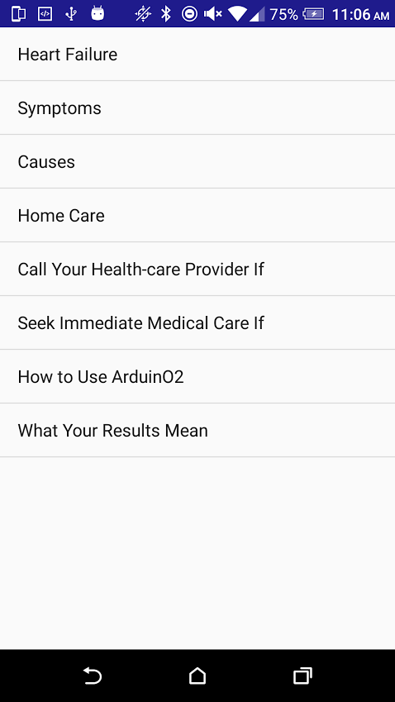
Education
The education tab provides information about heart health.

Slide 13
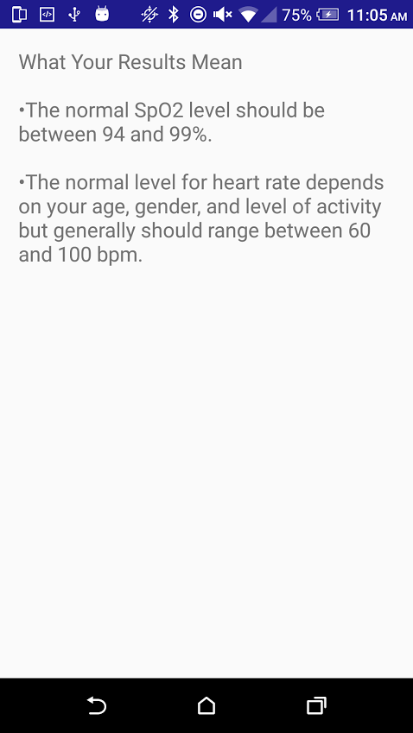
What Your Results Mean
This tab is provided as a guide to see what the normal rage is for SpO2 and general heart rate.

Slide 14
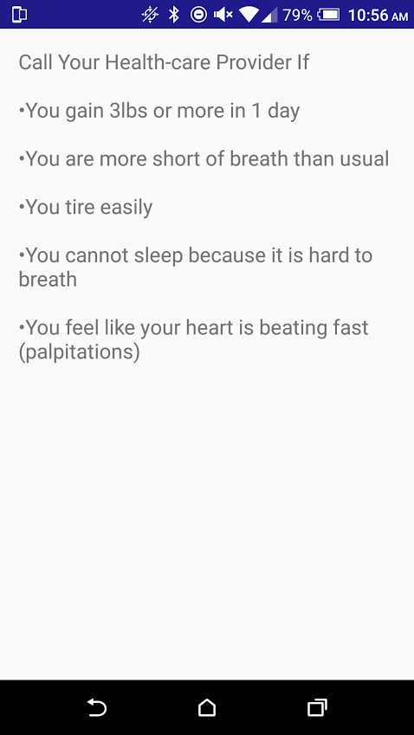
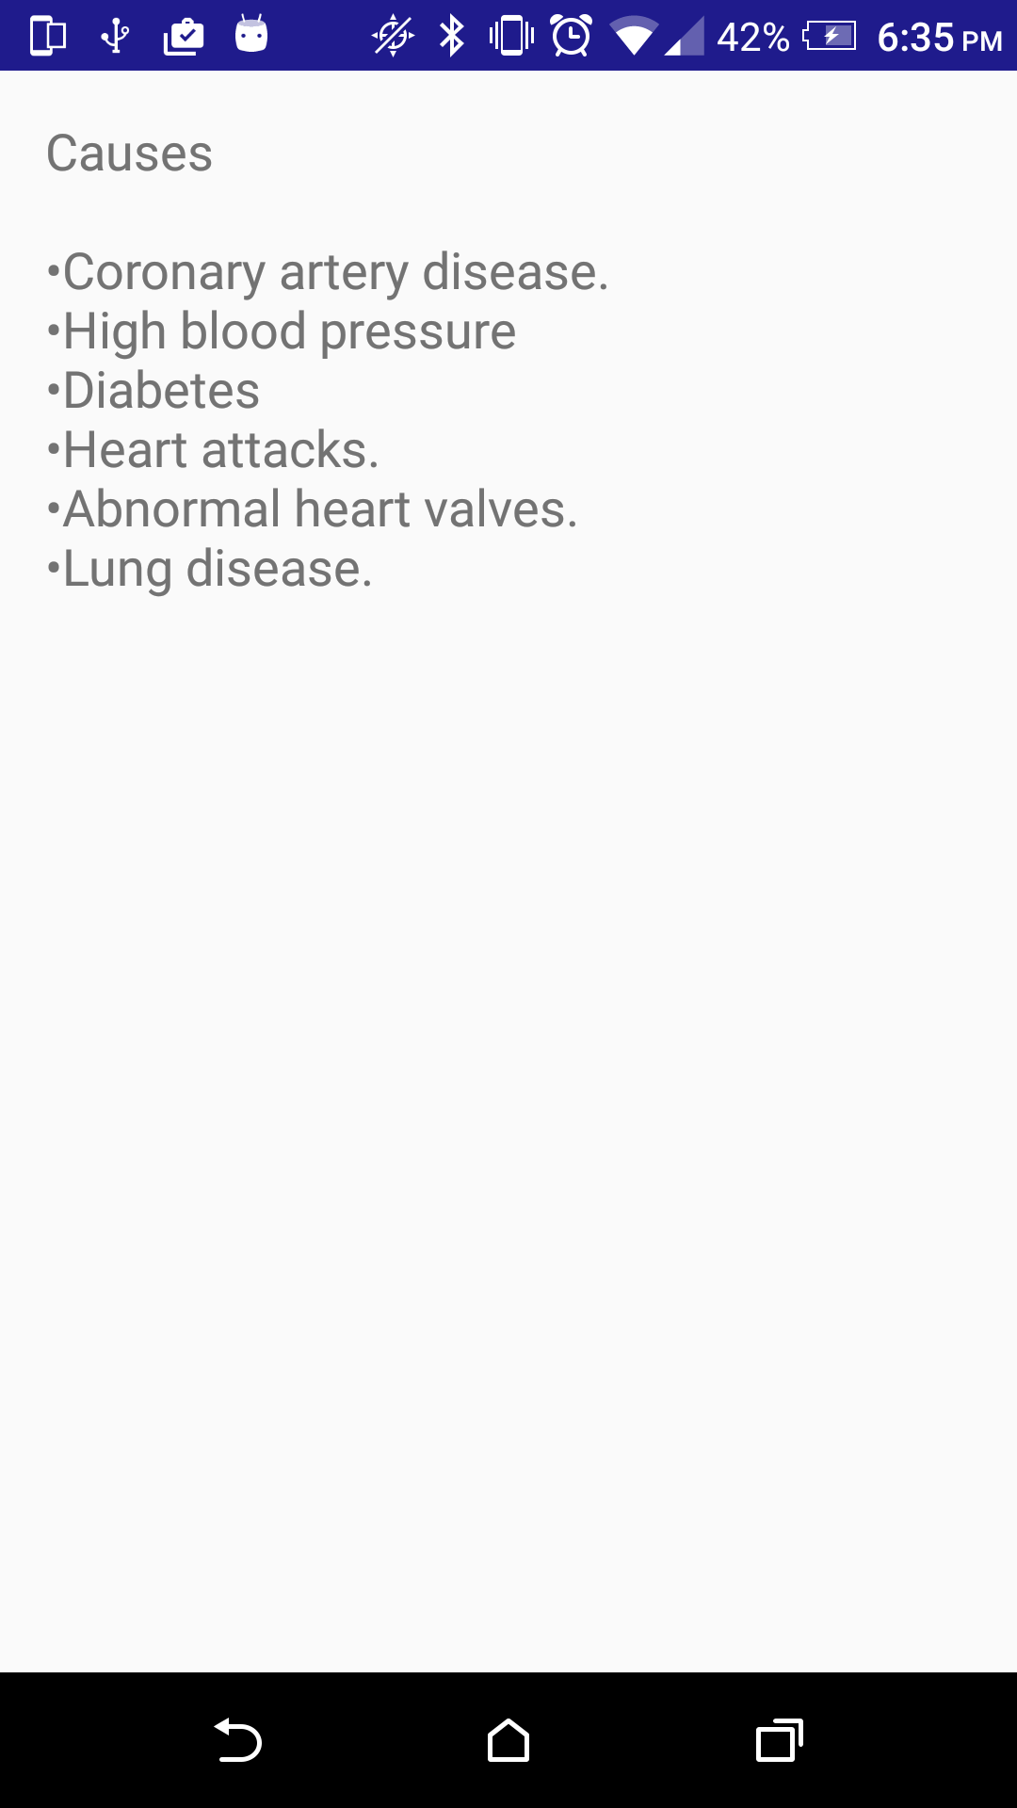
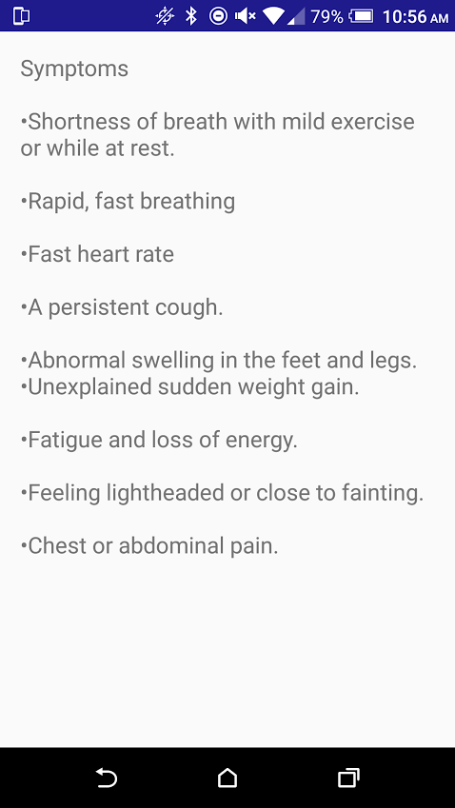
App Screens

